Slide 1
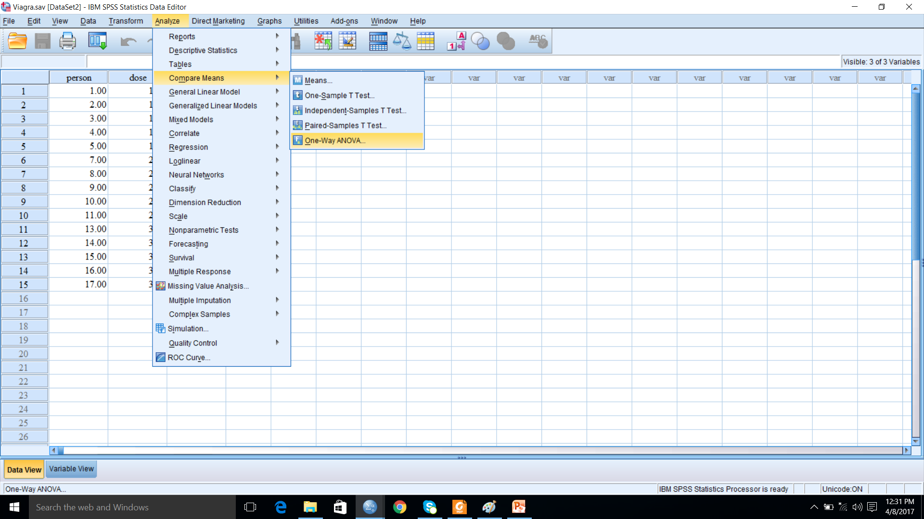
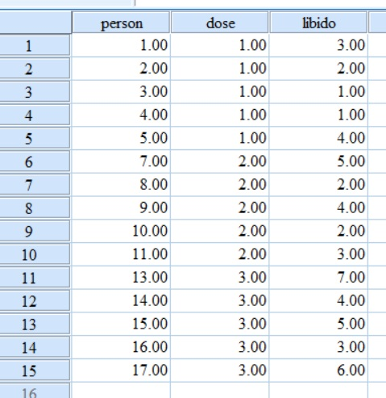
Parametric tests: Comparing several means: ANOVA
When you have more than two groups of data, then you may want to compare the those (multiple) means that comes from multiple groups of data.

Slide 2
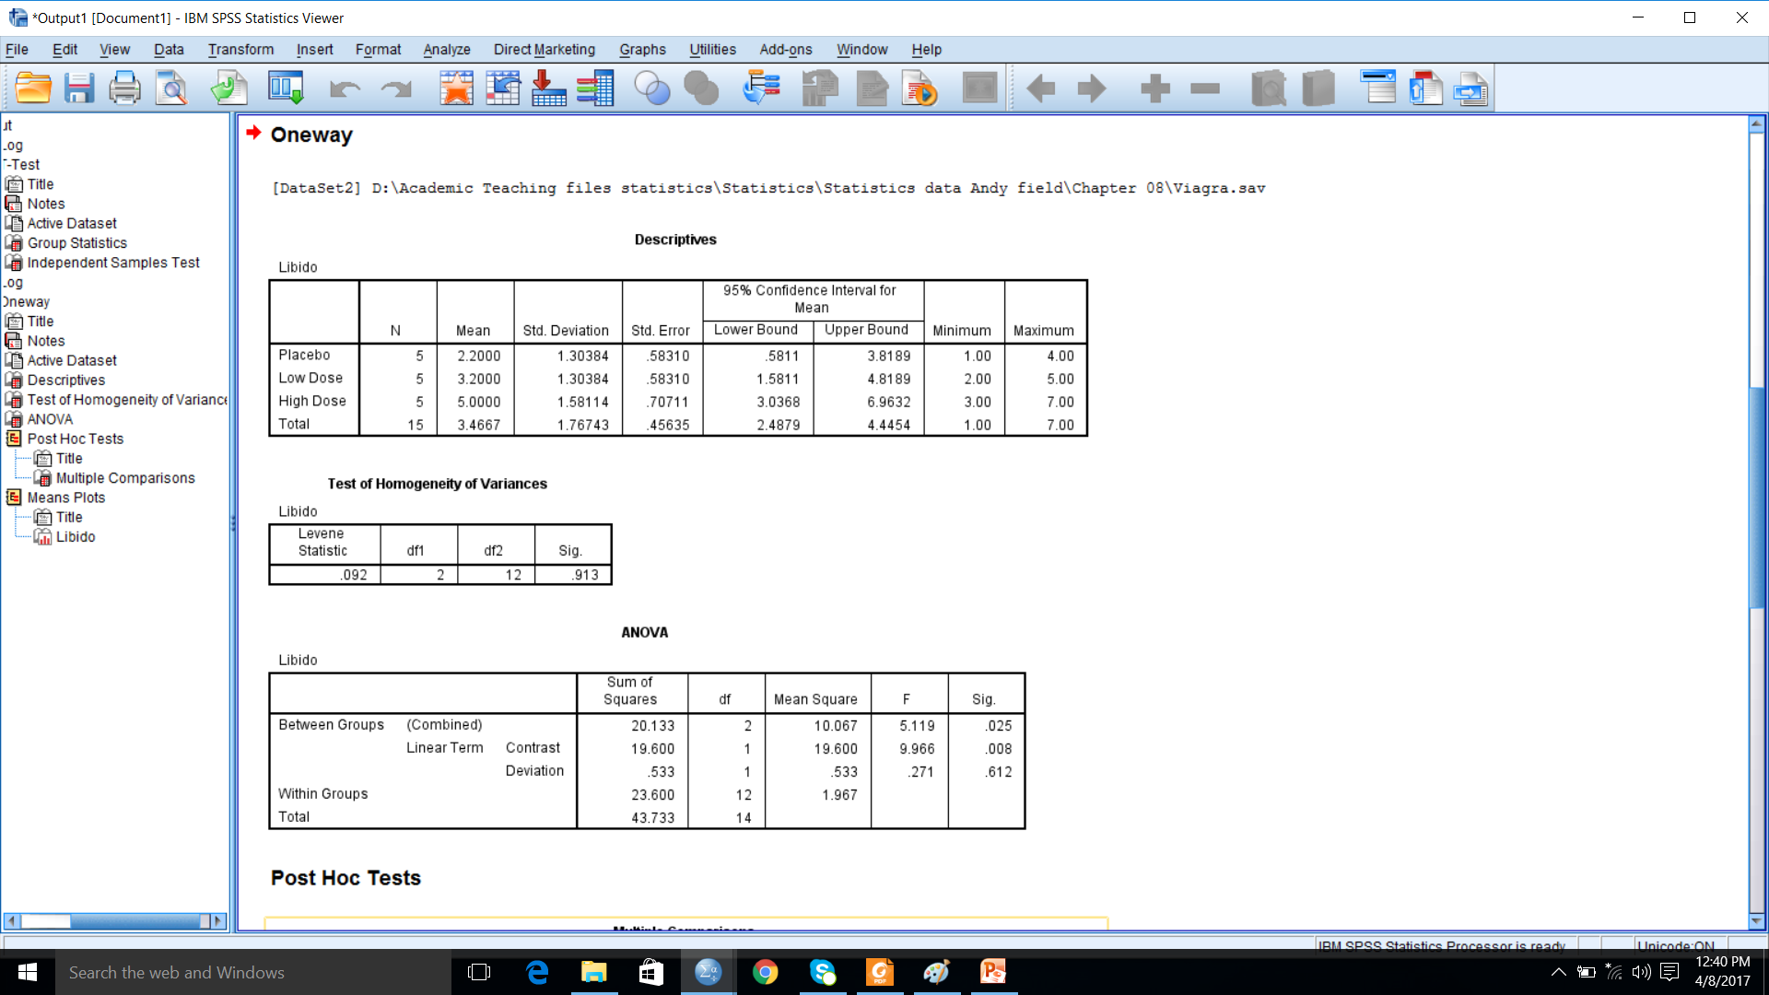
Output: ANOVA

Slide 3
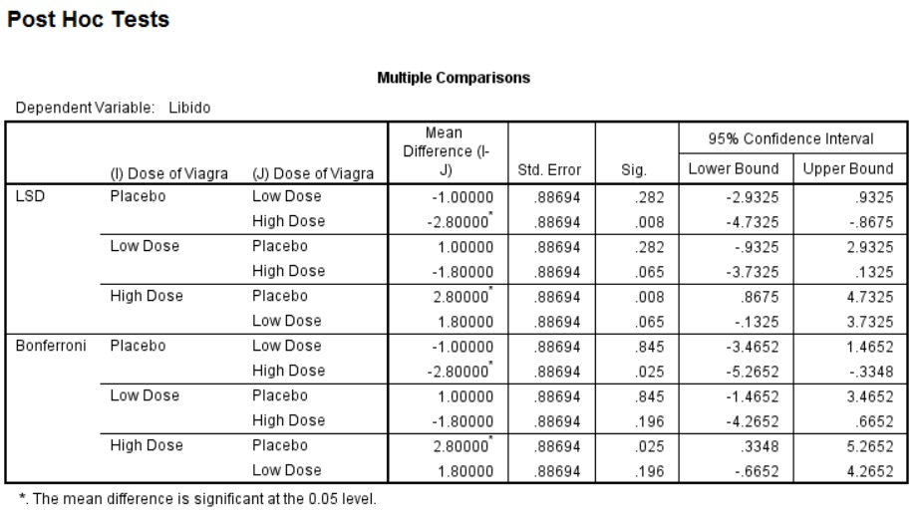
Post-hoc tests: to compare between groups

Slide 4
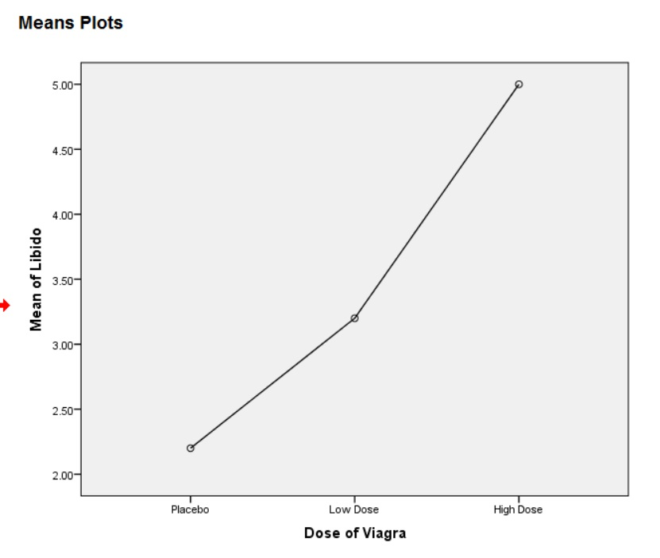
Means plot

Slide 5
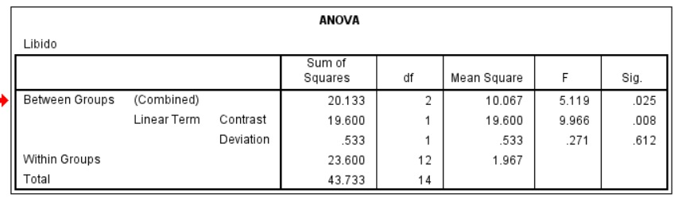

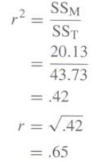
Computing effect size and reporting results
Reporting results from Independent one way ANOVA

